Slide 1
CHAPTER 17
APPLICATIONS OF SOFT COMPUTING
“Principles of Soft Computing, 2nd Edition”
by S.N. Sivanandam & SN Deepa
Copyright © 2011 Wiley India Pvt. Ltd. All rights reserved.

Slide 2
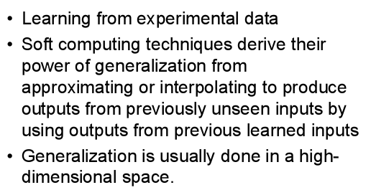
PROPERTIES OF SOFT COMPUTING
“Principles of Soft Computing, 2nd Edition”
by S.N. Sivanandam & SN Deepa
Copyright © 2011 Wiley India Pvt. Ltd. All rights reserved.

Slide 3
ADVANTAGES OF SOFT COMPUTING
Models based on human reasoning.
Models can be
linguistic,
simple (no number crunching),
comprehensible (no black boxes),
fast when computing,
good in practice.
“Principles of Soft Computing, 2nd Edition”
by S.N. Sivanandam & SN Deepa
Copyright © 2011 Wiley India Pvt. Ltd. All rights reserved.

Slide 4
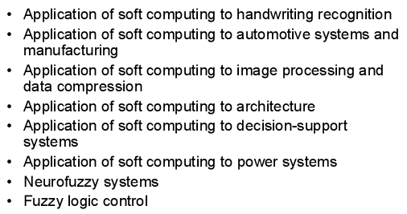
APPLICATIONS OF SOFT COMPUTING
“Principles of Soft Computing, 2nd Edition”
by S.N. Sivanandam & SN Deepa
Copyright © 2011 Wiley India Pvt. Ltd. All rights reserved.

Slide 5
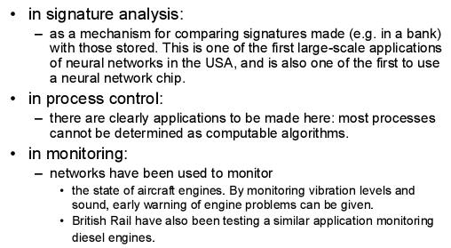
APPLICATIONS OF NEURAL NETWORKS
“Principles of Soft Computing, 2nd Edition”
by S.N. Sivanandam & SN Deepa
Copyright © 2011 Wiley India Pvt. Ltd. All rights reserved.

Slide 6
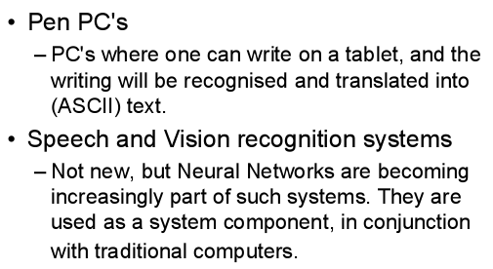
“Principles of Soft Computing, 2nd Edition”
by S.N. Sivanandam & SN Deepa
Copyright © 2011 Wiley India Pvt. Ltd. All rights reserved.

Slide 7
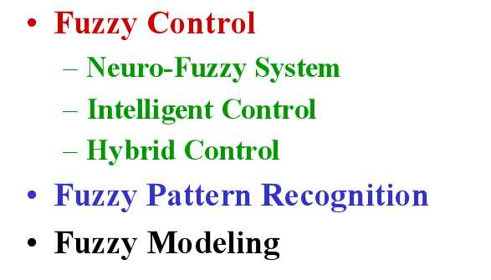
APPLICATIONS OF FUZZY LOGIC
“Principles of Soft Computing, 2nd Edition”
by S.N. Sivanandam & SN Deepa
Copyright © 2011 Wiley India Pvt. Ltd. All rights reserved.

Slide 8
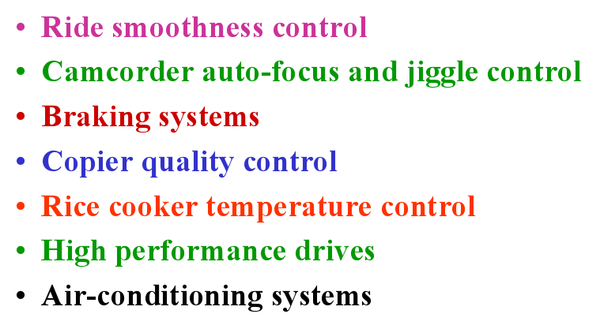
APPLICATIONS OF FUZZY LOGIC
“Principles of Soft Computing, 2nd Edition”
by S.N. Sivanandam & SN Deepa
Copyright © 2011 Wiley India Pvt. Ltd. All rights reserved.

Slide 9
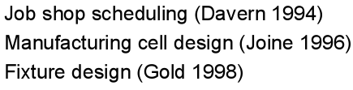
APPLICATIONS OF GENETIC ALGORITHM
Several Scheduling Problems,
Traveling Salesman Problem,
Energy Optimization and so on.
“Principles of Soft Computing, 2nd Edition”
by S.N. Sivanandam & SN Deepa
Copyright © 2011 Wiley India Pvt. Ltd. All rights reserved.

Slide 10
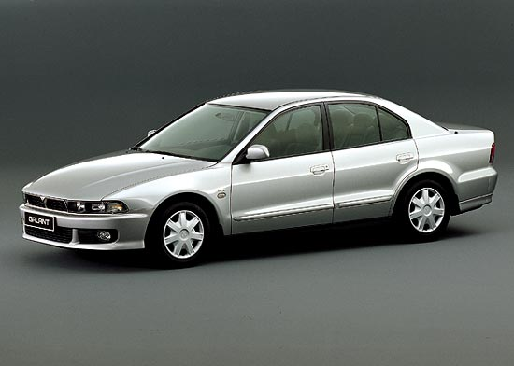

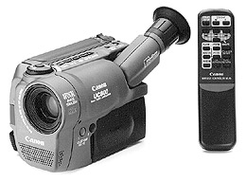
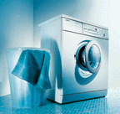
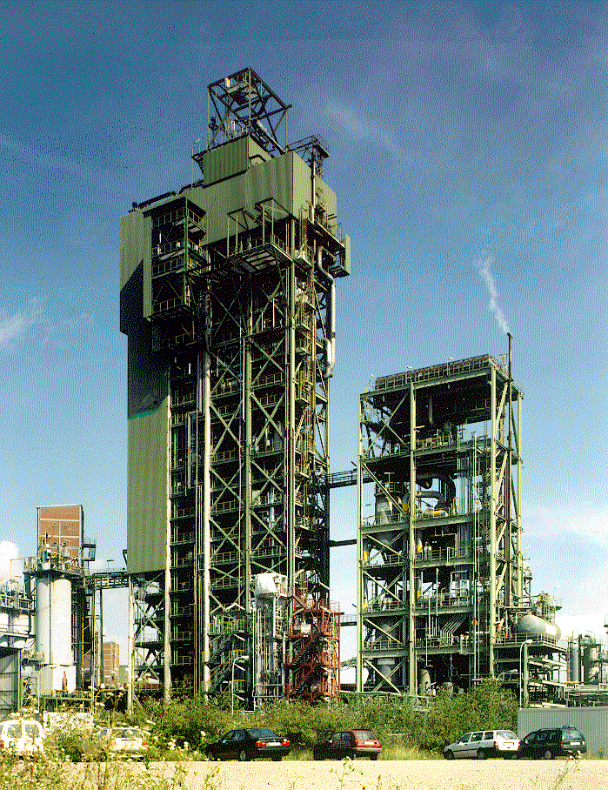
SOFT COMPUTING APPLICATIONS: CONTROL
Heavy industry (Matsushita, Siemens, Stora-Enso).
Home appliances (Canon, Sony, Goldstar, Siemens).
Automobiles (Nissan, Mitsubishi, Daimler-Chrysler, BMW, Volkswagen).
Spacecrafts (NASA).
“Principles of Soft Computing, 2nd Edition”
by S.N. Sivanandam & SN Deepa
Copyright © 2011 Wiley India Pvt. Ltd. All rights reserved.

Slide 11
SOFT COMPUTING APPLICATIONS: BUSINESS
supplier evaluation for sample testing,
customer targeting,
sequencing,
scheduling,
optimizing R&D,
projects,
knowledge-based prognosis,
fuzzy data analysis
hospital stay prediction,
TV commercial slot evaluation,
address matching,
fuzzy cluster analysis,
sales prognosis for mail order house,
multi-criteria optimization, etc.
“Principles of Soft Computing, 2nd Edition”
by S.N. Sivanandam & SN Deepa
Copyright © 2011 Wiley India Pvt. Ltd. All rights reserved.

Slide 12
SOFT COMPUTING APPLICATIONS: FINANCE
fuzzy scoring for mortgage applicants,
creditworthiness assessment,
fuzzy-enhanced score card for lease risk assessment,
risk profile analysis,
insurance fraud detection,
cash supply optimization,
foreign exchange trading,
insider trading,
trading surveillance,
investor classification, etc.
“Principles of Soft Computing, 2nd Edition”
by S.N. Sivanandam & SN Deepa
Copyright © 2011 Wiley India Pvt. Ltd. All rights reserved.

Slide 13
SOFT COMPUTING APPLICATIONS: OTHERS
Statistics
Social sciences
Behavioral sciences
Robotics
Biology
Medicine
“Principles of Soft Computing, 2nd Edition”
by S.N. Sivanandam & SN Deepa
Copyright © 2011 Wiley India Pvt. Ltd. All rights reserved.

Slide 14
SOFT COMPUTING APPLICATIONS – DEALT IN THIS CHAPTER
A Fusion Approach of Multispectral Images with SAR (Synthetic Aperture Radar) Image for Flood Area Analysis.
Optimization of Traveling Salesman Problem using Genetic Algorithm Approach.
Genetic Algorithm based Internet Search Technique.
Soft Computing Based Hybrid Fuzzy Controllers.
Soft Computing Based Rocket Engine Control.
“Principles of Soft Computing, 2nd Edition”
by S.N. Sivanandam & SN Deepa
Copyright © 2011 Wiley India Pvt. Ltd. All rights reserved.

Slide 15

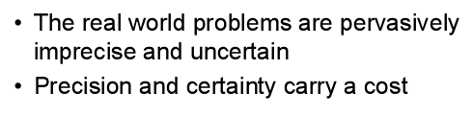
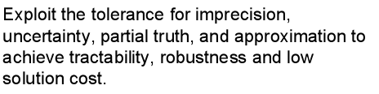
SUMMARY
“Principles of Soft Computing, 2nd Edition”
by S.N. Sivanandam & SN Deepa
Copyright © 2011 Wiley India Pvt. Ltd. All rights reserved.

